Slide 1
Bisection method – Error control

Slide 2
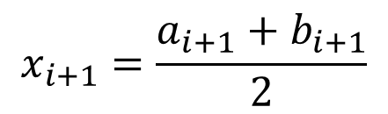
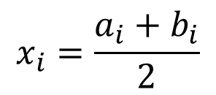
[a_{i}, b_{i}]
[a_{i+1}, b_{i+1}]
$$x_{i}=\frac{a_{i}+b_{i}}{2}$$
$$x_{i+1}=\frac{a_{i+1}+b_{i+1}}{2}$$
Bisection Algorithm
Notes:
Recall what we learned in the previous lecture. The bisection algorithm generates from an interval [ai, bi] a smaller interval [ai+1, bi+1] containing the root r we aim to locate.
The algorithm does this by cutting the interval [ai, bi] into two sub-intervals and determining in which one the root is located.
At every iteration we can estimate the root r by using the midpoint of the computed interval.
At this point we can use the bisection algorithm but we cannot yet solve nonlinear equations.
Indeed we have no idea how good or bad is our generated approximation xi+1.
At this stage our generated approximation xi+1 doesn't have any more value than a random number.
Let us now learn how we can estimate how far our approximation is away from the root we want to find.

Slide 3
Find an approximation x_{r} of f(x)=0 with an error below a given tolerance TOL
Bisection Algorithm
x_{i}
x_{i+1}
x_{r}=x_{i+1}
Error < TOL
Error > TOL
Notes:
In fact the problem we want to solve is the following one:
Find an approximation x_{r} of f(x)=0 with an error below a given tolerance TOL.
So far we know how we can at each iteration generate an approximation xi of the root. What we miss is the quality control.
We need to learn how we can decide if our approximation is closer to the root than the set tolerance or it is not.
If we can estimate the error at each iteration, we can take this decision.
The central question we have to address is how do we estimate this error?

Slide 4
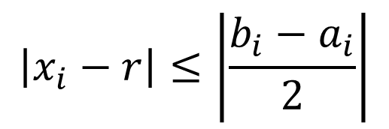
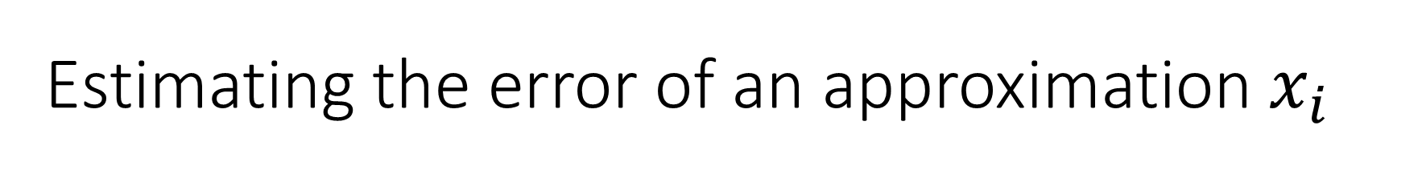




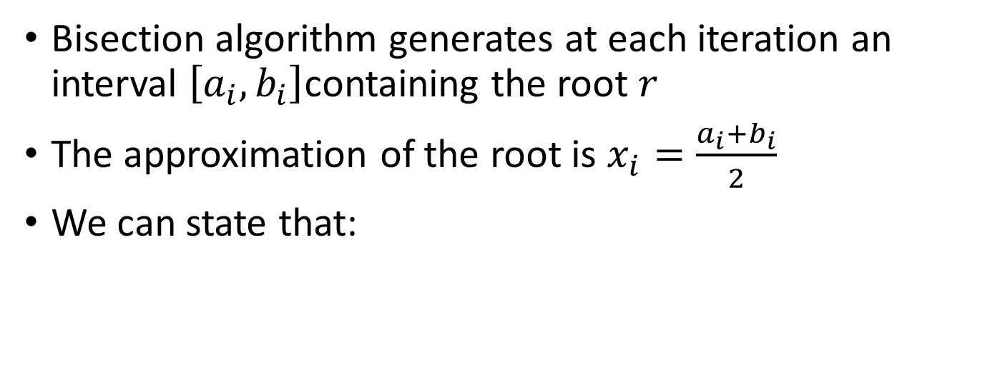

Estimating the error of an approximation $x_{i}$
Bisection algorithm generates at each iteration an interval $\left[a_{i},b_{i}\right]$containing the root $r$
The approximation of the root is $x_{i}=\frac{a_{i}+b_{i}}{2}$
We can state that:
x_{i}
$$\left|x_{i}−r\right|≤\left|\frac{b_{i}−a_{i}}{2}\right|$$
Error $≤\left|\frac{b_{i}−a_{i}}{2}\right|$
$$a_{i}$$
$$x_{i}$$
$$r$$
$$b_{i}$$
Notes:
To answer this question. let us develop a quality control strategy for an approximation xi of the root r.
We already know that the bisection algorithm generates at each iteration an interval $\left[a_{i},b_{i}\right]$ containing the root r
Further at each iteration we compute the approximation of the root as the midpoint of the interval, which is $x_{i}=\frac{a_{i}+b_{i}}{2}$
Because we know that the interval contains the root, we can state that the absolute error xi-r of the root must be at maximum half of the length of the interval, which is bi-ai divided by two.
This statement is obvious if we consider the figure.
We want to find the root r on the x axis.
The bisection algorithm did generate an interval $\left[a_{i},b_{i}\right]$ bracketing the root r.
The approximation of the root given by the algorithm is the midpoint xi of the interval.
It is obvious from the figure that the approximation xi is closer to the root r than half of the interval.
Note that this way to estimate the error is applicable for all bracketing methods. The only element we need in each iteration is an interval [ai, bi] containing the root. This is exactly what bracketing methods generate.

Slide 5
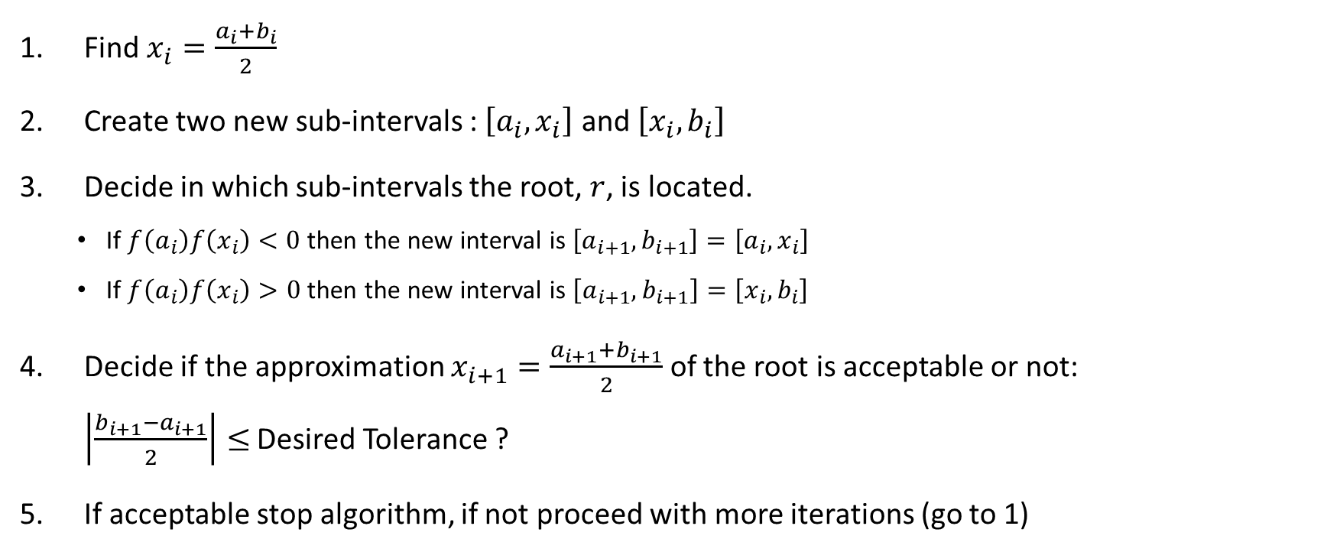
Bisection Algorithm with Error Control
Find $x_{i}=\frac{a_{i}+b_{i}}{2}$
Create two new sub-intervals : $\left[a_{i},x_{i}\right]$ and $\left[x_{i},b_{i}\right]$
Decide in which sub-intervals the root, $r$, is located.
If$f\left(a_{i}\right)f\left(x_{i}\right)<0$ then the new interval is$\left[a_{i+1},b_{i+1}\right]=\left[a_{i},x_{i}\right]$
If $f\left(a_{i}\right)f\left(x_{i}\right)>0$ then the new interval is $\left[a_{i+1},b_{i+1}\right]=\left[x_{i},b_{i}\right]$
Decide if the approximation $x_{i+1}=\frac{a_{i+1}+b_{i+1}}{2}$ of the root is acceptable or not: $\left|\frac{b_{i+1}−a_{i+1}}{2}\right|≤$ Desired Tolerance ?
If acceptable stop algorithm, if not proceed with more iterations (go to 1)
Notes:
We can now integrate the error control in our bisection algorithm.
In each iteration start by computing the midpoint xi of the interval [ai, bi]
Form the two sub-intervals decide in which interval is located based on the sign of f(ai)f(xi)
After selecting the correct interval, proceed with the quality control by comparing the estimated error with the preset tolerance.
Decide if the approximation is close enough to the root r based on the tolerance you would like to reach.
If the approximation is good enough you can stop the iterations. If not, you need to do more iterations.

Slide 6

Number of iterations required
The bisection algorithm cuts into two the interval [ai, bi] in each iteration
Consequently the error between the approximation xi and the root, will as well be cut into two at each iteration: $\left|x_{i+1}−r\right|≤\frac{\left|x_{i}−r\right|}{2}$
If we start with an initial interval $\left[a_{o},b_{o}\right]$ we have as initial error
$$\left|x_{o}−r\right|≤\frac{\left|b_{o}−a_{o}\right|}{2}$$
For the first iteration: $\left|x_{1}−r\right|≤\frac{\left|x_{o}−r\right|}{2}≤\frac{\left|b_{o}−a_{o}\right|}{2^{2}}$
And in general: $\left|x_{i}−r\right|≤\frac{\left|x_{i−1}−r\right|}{2}≤\frac{\left|x_{i−2}−r\right|}{2^{2}}≤⋯≤\frac{\left|b_{o}−a_{o}\right|}{2^{i+1}}$
Notes:
Now we know how to estimate the error of the approximation of the root in each iteration we can go one step further.
We can calculate the number of iterations that have to be performed in order to reach a given tolerance.
Recall that the bisection algorithm will cut into two the interval bracketing the root in each iteration.
Consequently the error between the approximation xi and the root, will as well be cut into two at each iteration and we can write:
xi+1-r is smaller or equal than xi-r divided by two.
If we start with an initial interval $\left[a_{o},b_{o}\right]$ we have as initial error bo-ao divided by two.
If we proceed with the first iteration we can further write:
$$\left|x_{1}−r\right|≤\frac{\left|x_{o}−r\right|}{2}≤\frac{\left|b_{o}−a_{o}\right|}{2^{2}}$$
It isn't hard to iterate further and you can easily verify the error xi-r at the iteration number i must be smaller or equal than bo-ao divided by 2^(i+1)

Slide 7
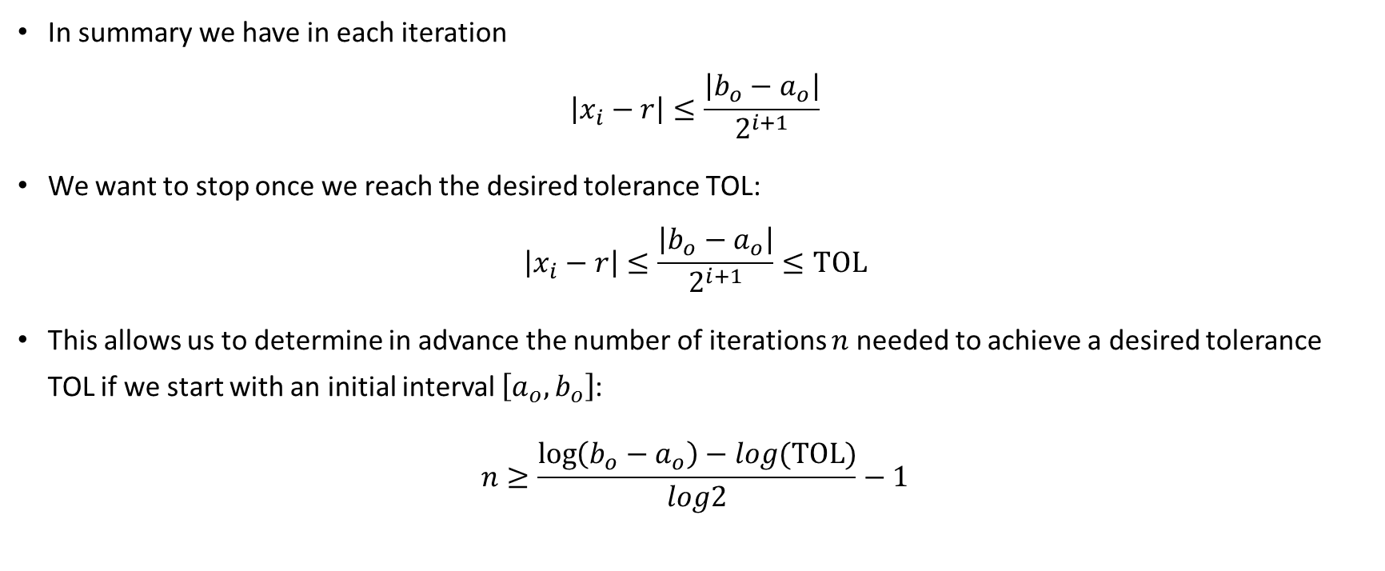
Number of iterations required
In summary we have in each iteration $\left|x_{i}−r\right|≤\frac{\left|b_{o}−a_{o}\right|}{2^{i+1}}$
We want to stop once we reach the desired tolerance TOL: $\left|x_{i}−r\right|≤\frac{\left|b_{o}−a_{o}\right|}{2^{i+1}}≤\text{TOL}$
This allows us to determine in advance the number of iterations $n$ needed to achieve a desired tolerance TOL if we start with an initial interval $\left[a_{o},b_{o}\right]$:
$$n≥\frac{\log\left(b_{o}−a_{o}\right)−log\text{(}\text{TOL}\text{)}}{log2}−1$$
Notes:
So far we determined that the error xi-r at the iteration number i must be smaller or equal than bo-ao divided by 2^(i+1)
We proceed with our iterations until our error becomes less than a desired tolerance.
That is until bo-ao dived by 2^(i+1) is smaller or equal than TOL
Solving this last inequation allows to compute the number of iterations n needed at least in order to reach an error less than the desired tolerance.

Slide 8
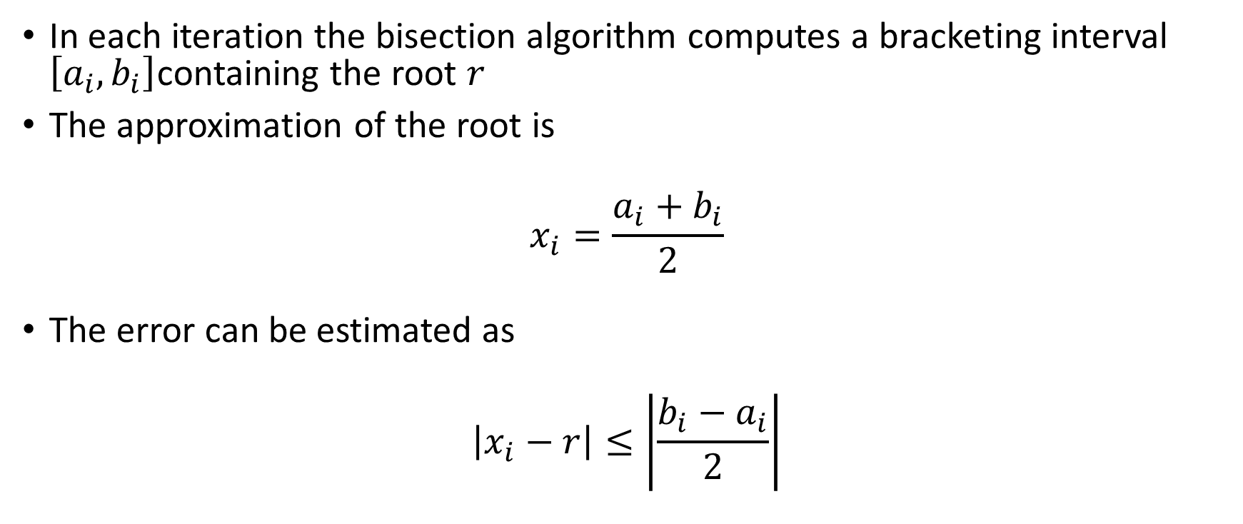
Summary
In each iteration the bisection algorithm computes a bracketing interval $\left[a_{i},b_{i}\right]$containing the root $r$
The approximation of the root is
$$x_{i}=\frac{a_{i}+b_{i}}{2}$$
The error can be estimated as
$$\left|x_{i}−r\right|≤\left|\frac{b_{i}−a_{i}}{2}\right|$$
Notes:
Let us summarize the key findings
The bisection algorithm provides in each iteration i an interval [ai, bi] bracketing the root r
The root is approximated as the midpoint of the interval, that is ai+bi dived by two
Error of the approximation is half of the size of the interval, that is bi-ai divided by two

